Slide 2
EXPERIENCE
North American
Ted Harris - Vice President, Product Development

Slide 3
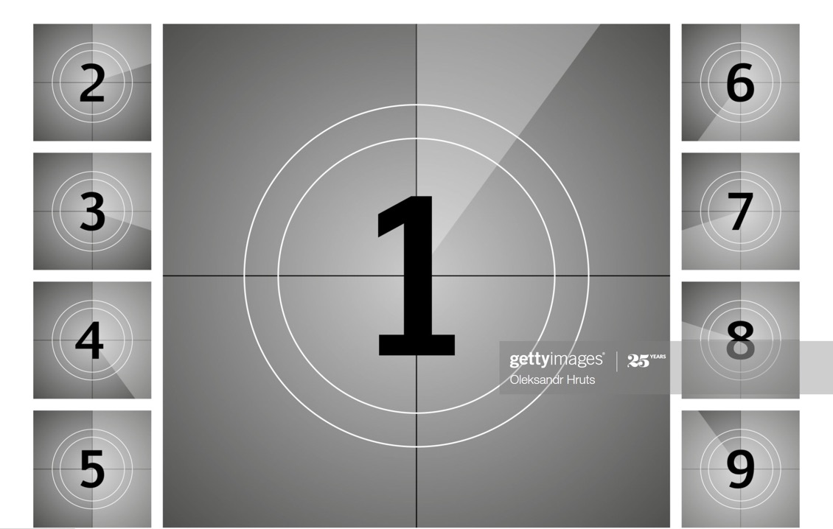



Slide 4
Disclosures
Sammons FinancialSM is the marketing name for Sammons® Financial Group, Inc.’s member companies, including North American Company for Life and Health Insurance. Annuities and life insurance are issued by, and product guarantees are solely the responsibility of, North American Company for Life and Health Insurance.

Slide 5
AGENDA Life insurance products
Reliable carrier to the member firm
RELIABLE
Unique recruiting tools
UNIQUE
Business growth potential for the agent
GROWTH

Slide 6

Reliable carrier
Trustworthy
ESOP ownership
Growth mode

Slide 7
Unique recruiting tools
Depth of product
No dual contracting
Not ubiquitous

Slide 8
Business growth
potential for the agent
NA toolkit northamericancompany.com/marketing-toolkit
Electronic end-to-end/
accelerated underwriting
Unrivaled RVP and internal support

Slide 9
RELIABLE
carrier to the member firm

Slide 10
UNIQUE
recruiting tools

Slide 11
Business
GROWTH
potential for the agent

Slide 12
EXPERIENCE
North American
Let us earn your business!

