Slide 2
Smart money
Help clients plan smarter using life insurance
Steve Zimmerman, CFP®, CLU, ChFC, AEP
-Regional Vice President

Slide 3
Disclosures
Sammons FinancialSM is the marketing name for Sammons® Financial Group, Inc.’s member companies, including North American Company for Life and Health Insurance. Annuities and life insurance are issued by, and product guarantees are solely the responsibility of, North American Company for Life and Health Insurance.
Agents offering, marketing, or selling accelerated death benefits for chronic illness in California must be able to describe the differences between benefits provided under an accelerated death benefit for chronic illness and benefits provided under long-term care insurance to clients. You must provide clients with the ADBE Consumer Brochure for California that includes this comparison. Comparison is for solicitation purpose only, not for conversions.
Indexed universal life insurance products are not an investment in the “market” or in the applicable index and are subject to all policy fees and charges normally associated with most universal life insurance.
Smart Builder IUL (policy form series LS187), or state variations, including all applicable endorsements and riders, and the Waiver of Surrender Charge Option Rider (form series LR479) are issued by North American Company for Life and Health Insurance, Administrative Office, One Sammons Plaza, Sioux Falls, SD 57193. Products, features, riders, endorsements or issue ages may not be available in all jurisdictions. Limitations and restrictions may apply.

Slide 4
Smart phones
Notes:
There has been a significant evolution in technology. Do you have a smart phone? You probably have it sitting on your desk in front of you now.

Slide 5
Smart TVs
Notes:
How about smart TVs? Many of us are enjoying movies on demand, and benefiting from new ways to use our TVs

Slide 6

Smart Money
Smart Money
Discovering assets clients have set aside and using them for life insurance
Notes:
Do you have smart money?
Smart money is funds that clients want to retain as both accessible and with limited exposure to loss of value. These are funds clients want to have control over in the event they may need it.
The Smart Builder product is a very effective solution for these needs.

Slide 7
Help solve the
retirement puzzle
Help clients plan better
with smart money
Notes:
We will talk about helping plan for a better retirement.
We will show you how we can address financial challenges and accomplish their goals.

Slide 8



AGENDA Smart money
Leverage
Liquidity
Legacy
Notes:
Leverage Ways to improve what your low yielding assets can do for you
Liquidity Ways to maintain control and access to your money
Legacy How to improve the future positive impact of you legacy to your loved ones.

Slide 9
Leverage
Retirement income
Inflation hedge
Downside protection
Tax deferral
Notes:
Retirement Income – With many facing challenges to maintain sufficient retirement income, Smart Builder can be a great source of supplemental retirement income.
Inflation Hedge – Because this is an IUL product, the policy holder will benefit from positive movements in chosen Index selections. We have 10 different options to choose form.
Downside Protection – Another strong benefit is downside protection, your clients will sleep well at night knowing they have protection from major market corrections.
Tax Deferral – No one has a crystal ball, but it’s safe to say taxes are likely to go up long term. Helping clients manage taxes has never been more important.

Slide 10
Liquidity¹
Waiver of Surrender Charge Option Rider²
available on North American’s Smart Builder
indexed universal life (IUL) insurance
Supplemental income
Accelerated death benefit
endorsement³
  Critical
  Chronic
  Terminal
1.In some situations loans and withdrawals may be subject to federal taxes. North American does not give tax or legal advice. Clients should be instructed to consult with and rely on their own tax advisor or attorney for advice on their specific situation. Income and growth on accumulated cash values is generally taxable only upon withdrawal. Adverse tax consequences may result if withdrawals exceed premiums paid into the policy. Withdrawals or surrenders made during a Surrender Charge period will be subject to withdrawal charges, processing fees, or surrender charges, and may reduce the ultimate death benefit and cash value. Surrender charges vary by product, issue age, sex, underwriting class, and policy year.
2. Only available at issue. Available for an additional charge per $1,000 per month, depending on issue age and underwriting class.
3.Subject to eligibility requirements.
Notes:
Waiver of Surrender Charge – If this optional rider is added, you will enjoy year one liquidity without surrender charges. Keep in mind, early performance without it is still extremely strong, and is better ling term in many cases.
Supplemental Income – We can run the illustration either as a single premium “MEC”, or as a flex-pay with tax free distributions
Accelerated Death Benefit – Think “CCT” Chronic, Critical & Terminal
Chronic - Long Term Care type needs
Critical – Cancer, Stroke, Heart Attack, Organ Transplant & Kidney Failure
Terminal – 24 Months

Slide 11
Legacy
Leveraged death benefit
Generally income tax free
Bypasses probate
Notes:
Leveraged Death Benefit – Because it’s life insurance, you will leave a leveraged legacy, more for the ones you love.
Generally Income tax free – Life insurance death benefit passes income tax free. Also, with the 2020 tax exemption above $11.58 million dollars most clients won’t need to structure ownership outside their estate.
Bypasses Probate – Simplify estate administration, life insurance proceeds bypass probate.

Slide 12

Smart Money: Case Study
Hypothetical Example
Male, 60-years-old with a death benefit need
400K in low interest bearing accounts
No plans for the Money
Notes:
60 year old male: $400K in low interest bearing accounts. No plans for the money. Would like to pass it on to his children. Concerned about healthcare costs.

Slide 13
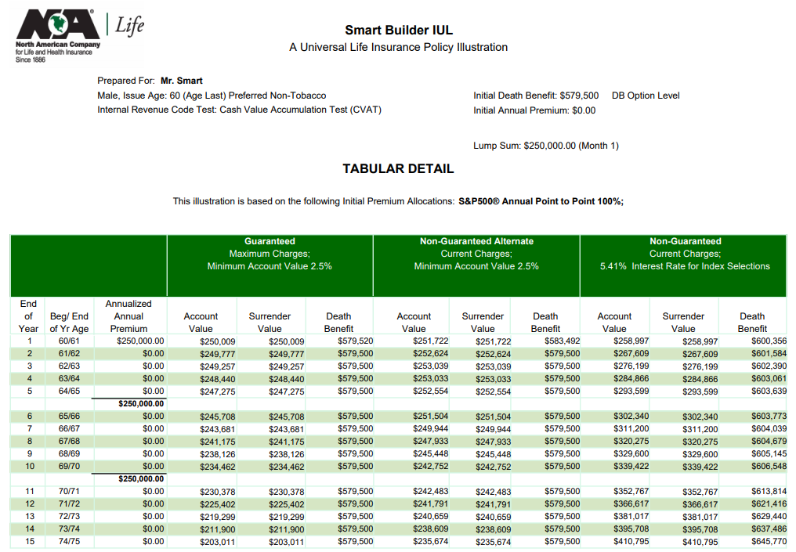
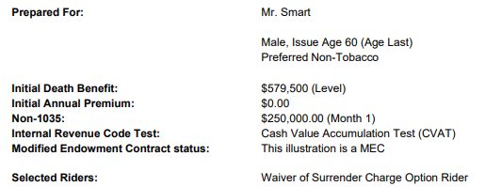




Smart Money: Case Study Hypothetical Example
$250,000K Lump Sum
Source: NA Web Based Software 2/2020. The information presented is hypothetical and not intended to project or predict investment results. Illustrations are not complete unless all pages are included.
Notes:
Illustration M60 PFD NT / $250K Lump Sum / WOSC / Illustrated @ 5.41%
Client Objectives – Improve returns without taking excessive risks / Liquidity / Legacy
Illustration – year one – values
Year one (Guaranteed) Surrender Value $250,009 Death Benefit $579,520
Year One (Non-Guaranteed) Surrender Value $258,997 Death Benefit $600,356
Consider how you want to show the middle “non-guaranteed alternate” assumptions. In the examples earlier I showed a 2.5% interest rate which is our guaranteed interest rate over the life of the policy. However you may also choose to just show a more conservative rate instead. This column must show rates at least 2% lower than the non-guaranteed rate used.
What if they don’t like indexed universal life? Is there a fixed UL alternative? Essentially, yes there is. Remember that IUL is either an indexed OR fixed account. If they don’t like indexed crediting method, the same concept can essentially be achieved by putting funds in the fixed account – or putting some of the funds in the fixed account to be more conservative.
Illustration
Male age 60 PFD NT
$250k lump sum
WOSC
Illustrated rate 5.41%

Slide 14
Summary
Leverage – Better asset management
Liquidity – Access to potential cash value when clients need it
Legacy – Enhanced legacy with retained control and access
Notes:
Leverage Better Asset Management
Liquidity Access to potential cash value when clients need it
Legacy Enhanced legacy with retained control and access

Slide 15
Better retirement
planning with
smart money
For clients:
  Less stress and worry about their retirement
For agents:
  Deepen client relationships and grow their business
Notes:
For clients Less stress and worry about their retirement
For Your Advisors Deeper client relationships and more business

Slide 16
Next steps
Help you put a plan in motion
Schedule call with North American RVP
Tactical Sales Plan
Advisor facing marketing
Contact your regional vice president
or internal wholesaler to learn more!
Notes:
Schedule a call with your North American RVP
Develop your own specific tactical sales plan
Host advisor facing sales meetings

Slide 17

EXPERIENCE
North American
Let us earn your business!

