Slide 2
Using life insurance to make you whole again
Andrew Herrera -Regional Vice President

Slide 3
Disclosures
These disclosures pertain to all slides in this presentation in its entirety.
THE S&P 500® COMPOSITE STOCK PRICE INDEX;
THE S&P 400® COMPOSITE STOCK PRICE INDEX
These Indices do not include dividends paid by the underlying companies.
The S&P MidCap 400® and the S&P 500® Indices are products of S&P Dow Jones Indices LLC (“SPDJI”), and has been licensed for use by North American Company for Life and Health Insurance (the Company). Standard & Poor’s®, S&P®, S&P MidCap 400® and S&P500® are registered trademarks of Standard & Poor’s Financial Services LLC (“S&P”); Dow Jones® registered trademark of Dow Jones Trademark Holdings LLC (“Dow Jones”); and these trademarks have been licensed for use by SPDJI and sublicensed for certain purposes by the Company. The Company’s Product(s) are not sponsored, endorsed, sold or promoted by SPDJI, Dow Jones, S&P, their respective affiliates, and none of such parties make any representation regarding the advisability of investing in such product(s) nor do they have any liability for any errors, omissions, or interruptions of the S&P MidCap 400® and S&P 500® Indices.
Agents offering, marketing, or selling accelerated death benefits for chronic illness in California must be able to describe the differences between benefits provided under an accelerated death benefit for chronic illness and benefits provided under long-term care insurance to clients. You must provide clients with the ADBE Consumer Brochure for California that includes this comparison. Comparison is for solicitation purpose only, not for conversions.
ADDvantage Term (policy form series LS174) or state variations, including all applicable endorsements and riders are issued by North American Company for Life and Health Insurance, Administrative Office, One Sammons Plaza, Sioux Falls, SD 57193. Products, features, riders, endorsements or issue ages may not be available in all jurisdictions. Limitations and restrictions may apply.
Sammons FinancialSM is the marketing name for Sammons® Financial Group, Inc.'s member companies, including North American Company for Life and Health Insurance®. Annuities and life insurance are issued by, and product guarantees are solely the responsibility of, North American Company for Life and Health Insurance.

Slide 4
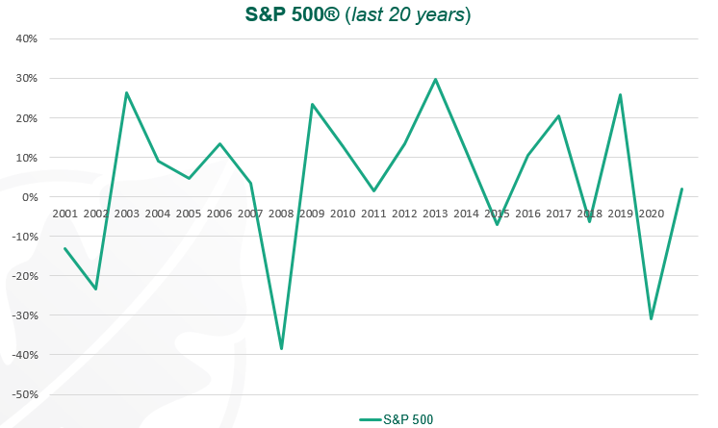

Source - Information taken from “S&P 500 Historical Index Change Detail” page on North American IUL Illustration.
Notes:
Information taken from “S&P 500 Historical Index Change Detail” page on North American IUL Illustration
As you can see here, the S&P 500 has shown some volatility over the last 20 years. This could have an impact on a client’s portfolio. The points in red are two recent downturns – the Great Recession of ‘08 and then earlier this year when COVID-19 created a downturn.

Slide 5
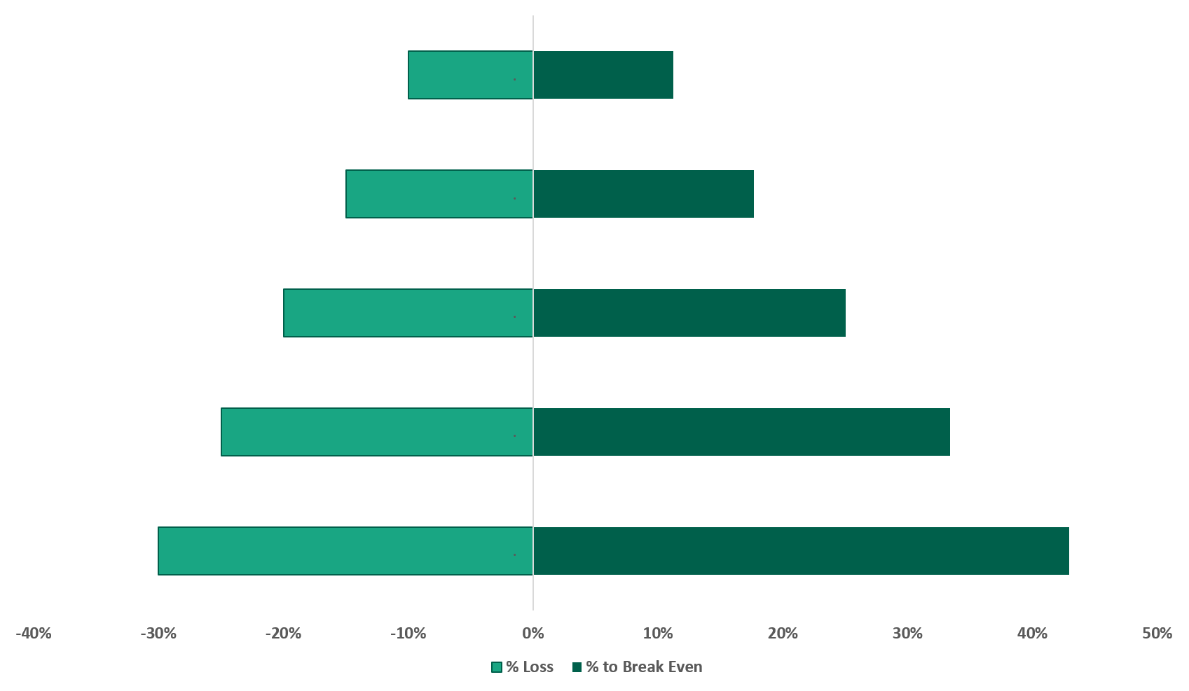
The break-even burden
Example:
-10%
11.2%
Percentage
of loss
Return to “break
even” after 1 year
-15%
17.7%
-20%
25%
-25%
33.4%
-30%
42.9%
Notes:
Taken from annuity marketing piece 27272Z-P.
- Clients sometime don’t understand that even when there is a downturn – of let’s say 10%. A rebound of 10% does not mean you’ve broken even. In fact, the amount needed to fully recover is higher than the downturn. See the slide on how, for example in a 30% downturn you would actually need 42.9% upswing to bring you back to even.

Slide 6
Recover with life insurance
Notes:
Need new title and new picture

Slide 7

AGENDA Recover with life insurance
Reduction
Result
Recovery
Notes:
Need new title and new pics
- Today I’d like to briefly cover 3 topics – reduction, result, and recovery

Slide 8
Reduction
Market downturn
Effect on portfolio
“Break even” point
Notes:
Reduction
- We saw earlier the impact a down market could have on a client's assets. Depending on their exposure, the reduction in their values can be very impactful. We also saw that the road to recovery is not as easy as making up the losses. The break even point is higher than the loss.

Slide 9
Result
Net worth decline
Less benefit to heirs
Need time to recover
Notes:
Result
The result of a decline and reduction is that one’s value is lower. If a client's assets have been reduced, they are not worth as much as they were prior to those assets losing value. What happens if they pass away? Will less be passed on to their spouse? Their kids? How long will it take to make up any losses? These are all important questions. And while it is unknown how long it will take, if ever, to recover one’s losses – what is known is that life insurance can fill the gap and provide the protection needed today.

Slide 10

Recovery
Term to cover the gap
Low cost death benefit protection
ADDvantage® Term
- Conversion
- Living benefits¹
1. Subject to eligibility requirements.
Notes:
North American’s ADDvantage Term can make the client whole today. They don’t need to worry about passing on less money their loved ones if they pass away because the gap is filled. Moreover, term is a cost efficient way to accomplish that goal.
ADDvantage Term is offered in 10, 15, 20, and 30 year durations. It has competitive premiums, is convertible to any permanent product, and includes Living Benefits.

Slide 11
Hypothetical case study
59 years old
Death benefit need - $1M
Loss of asset value
Notes:
- Now let’s look at a case study. Here we have a 59-year-old with a death benefit need. She recently has experienced a loss in the value of her assets.

Slide 12
Hypothetical case study
Notes:
- Here is a hypothetical example of her assets. On the left you can see the value before any downturn and on the right, you can see how they’ve been impacted and are now valued at less.

Slide 13
Hypothetical case study
Notes:
- So continuing with our hypothetical example – you see that if she were to pass away, the value of her assets would be less and therefore her heirs would get less. But on the right we see that she has purchased a $1mm term policy. That immediately boosts her overall assets and now she has the peace of mind knowing she will not leave less to her loved ones.

Slide 14
Summary
Reduction – Client’s assets affected by downturn
Result – Less money to pass on to heirs
Recovery – Use Term to make up the difference
Notes:
- In summary, we talked about reduction, how a client’s assets may have been affected in a downturn. Result, how that would mean less money to pass on to heirs, and lastly recovery, how you can use term to cover the gap and make up the difference.

Slide 15
Help preserve the
client’s net worth
with life insurance
For clients:
  Provides a death benefit and buys time for their assets to rebound
For financial professionals:
  Provides a client solution for downturns and the ability to help grow their own book of business
Notes:
So what this means for clients, is it can provide a death benefit to them as well as making them whole again for any losses. For the financial professional, this is another concept they can run with to help their clients and help grow their book of business.

Slide 16
Next steps
Help your financial professionals provide this solution
Identify clients with a death benefit need and opportunities in the portfolio
Educate them on a solution and ADDvantage Term
Promote the client solution
Contact your regional vice president
or internal wholesaler to learn more!

Slide 17

EXPERIENCE
North American
Let us earn your business!

