Slide 1
Page 1 of 17

Slide 2

Exploring
fixed index
annuities
Financial Professionals are independent agents contracted with North American Company for Life and Health Insurance®.
Page 2 of 17
Notes:
How you can use this kit with clients
Client presentation
The front of each page features client-friendly valuable information, graphics, and even interactive pieces to help you get the conversation going.
Financial professional notes
The notes section of each page can help guide you through the kit with talking points and important reminders.
You can use this checklist to understand some of your client’s most pressing concerns. This can help start the conversation about financial needs in retirement.

Slide 3


Common client
concerns
Which ones are you most worried about?
Outliving my money
Flexibility/liquidity of my money
Maintaining my current lifestyle through retirement
Protecting my premium
Social Security may not be available
Need for nursing home care
Page 3 of 17
Notes:
This conversation may help you understand your clients’ goals and determine an appropriate product direction. Familiarize yourself with our portfolio using the product overview (form 24279Z).

Slide 4

Is a fixed annuity
right for you?
Which of these benefits are you interested in?
Income for life
Protecting premium
Guaranteed rate of return
Potential for growth
Tax deferral
Access to a portion of my money (liquidity)
Leaving a legacy/death benefit
Page 4 of 17
Notes:
Looking for additional helpful resources for your clients?
Find client-friendly stats, flyers, videos and more on the Indexed Annuity Leadership Council (IALC) website.
http://indexedannuitiesinsights.com

Slide 5

What is a fixed
index annuity or
FIA?
Fixed
Index
Annuity
Fixed index annuities are contracts with insurance companies that generally offer certain guarantees, such as not losing value due to market downturns.
A fixed index annuity is a unique annuity that credits interest to your annuity’s value based upon the movement of an underlying
market index. Growth of a FIA is calculated based on the index it is linked to, and how that index performs.
An annuity is a contract in which an insurance company grows client premium and then may make a series of income payments at regular intervals. These payments can be immediate or deferred depending on the annuity type. Annuities are most often bought for accumulation and future retirement income.
Page 5 of 17

Slide 6
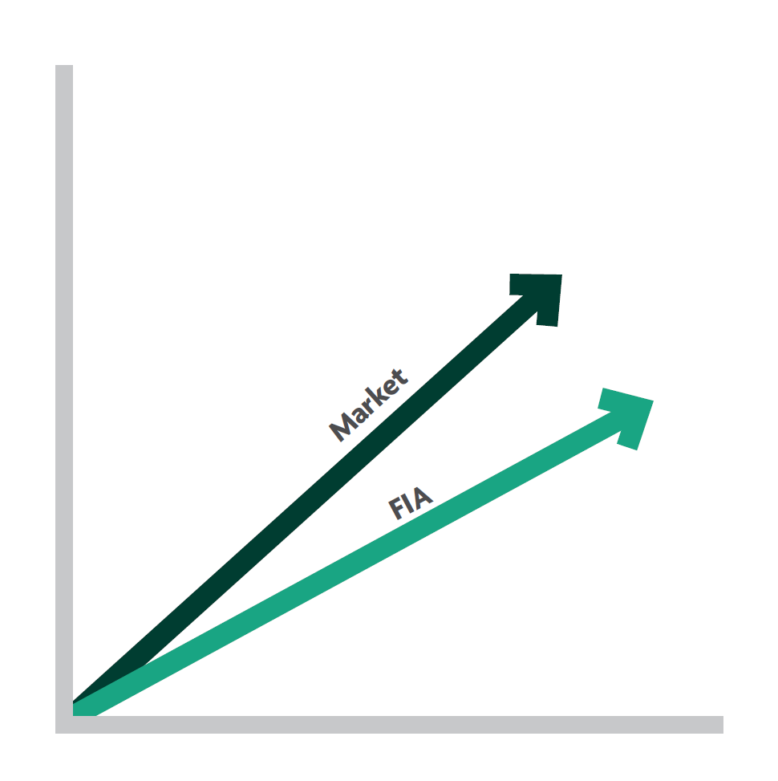
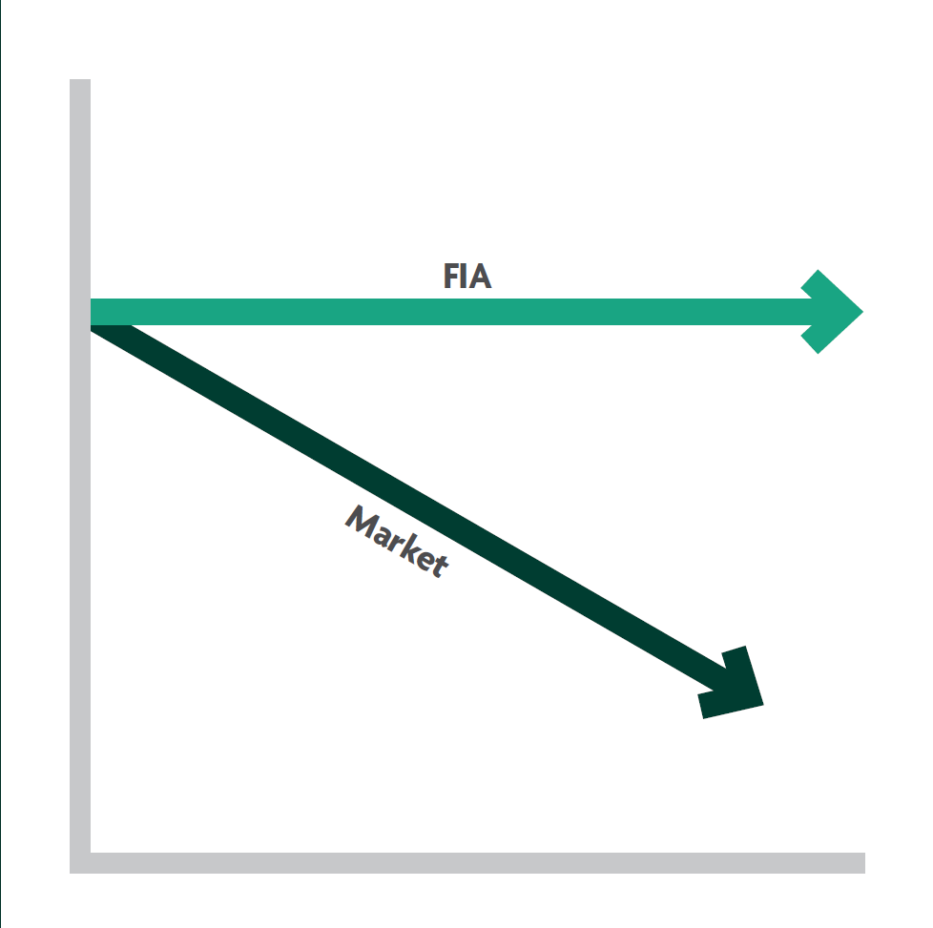
Each FIA product generally credits a portion of the total
index gain based on the crediting method chosen, but
does not lose value due to market downturns.
In an up market
In a market downturn
Page 6 of 17
Notes:
The cap, participation rate, and margin differ by product and are declared annually (or by term). Product illustrations before your client meeting may help provide greater understanding of these product features.

Slide 7
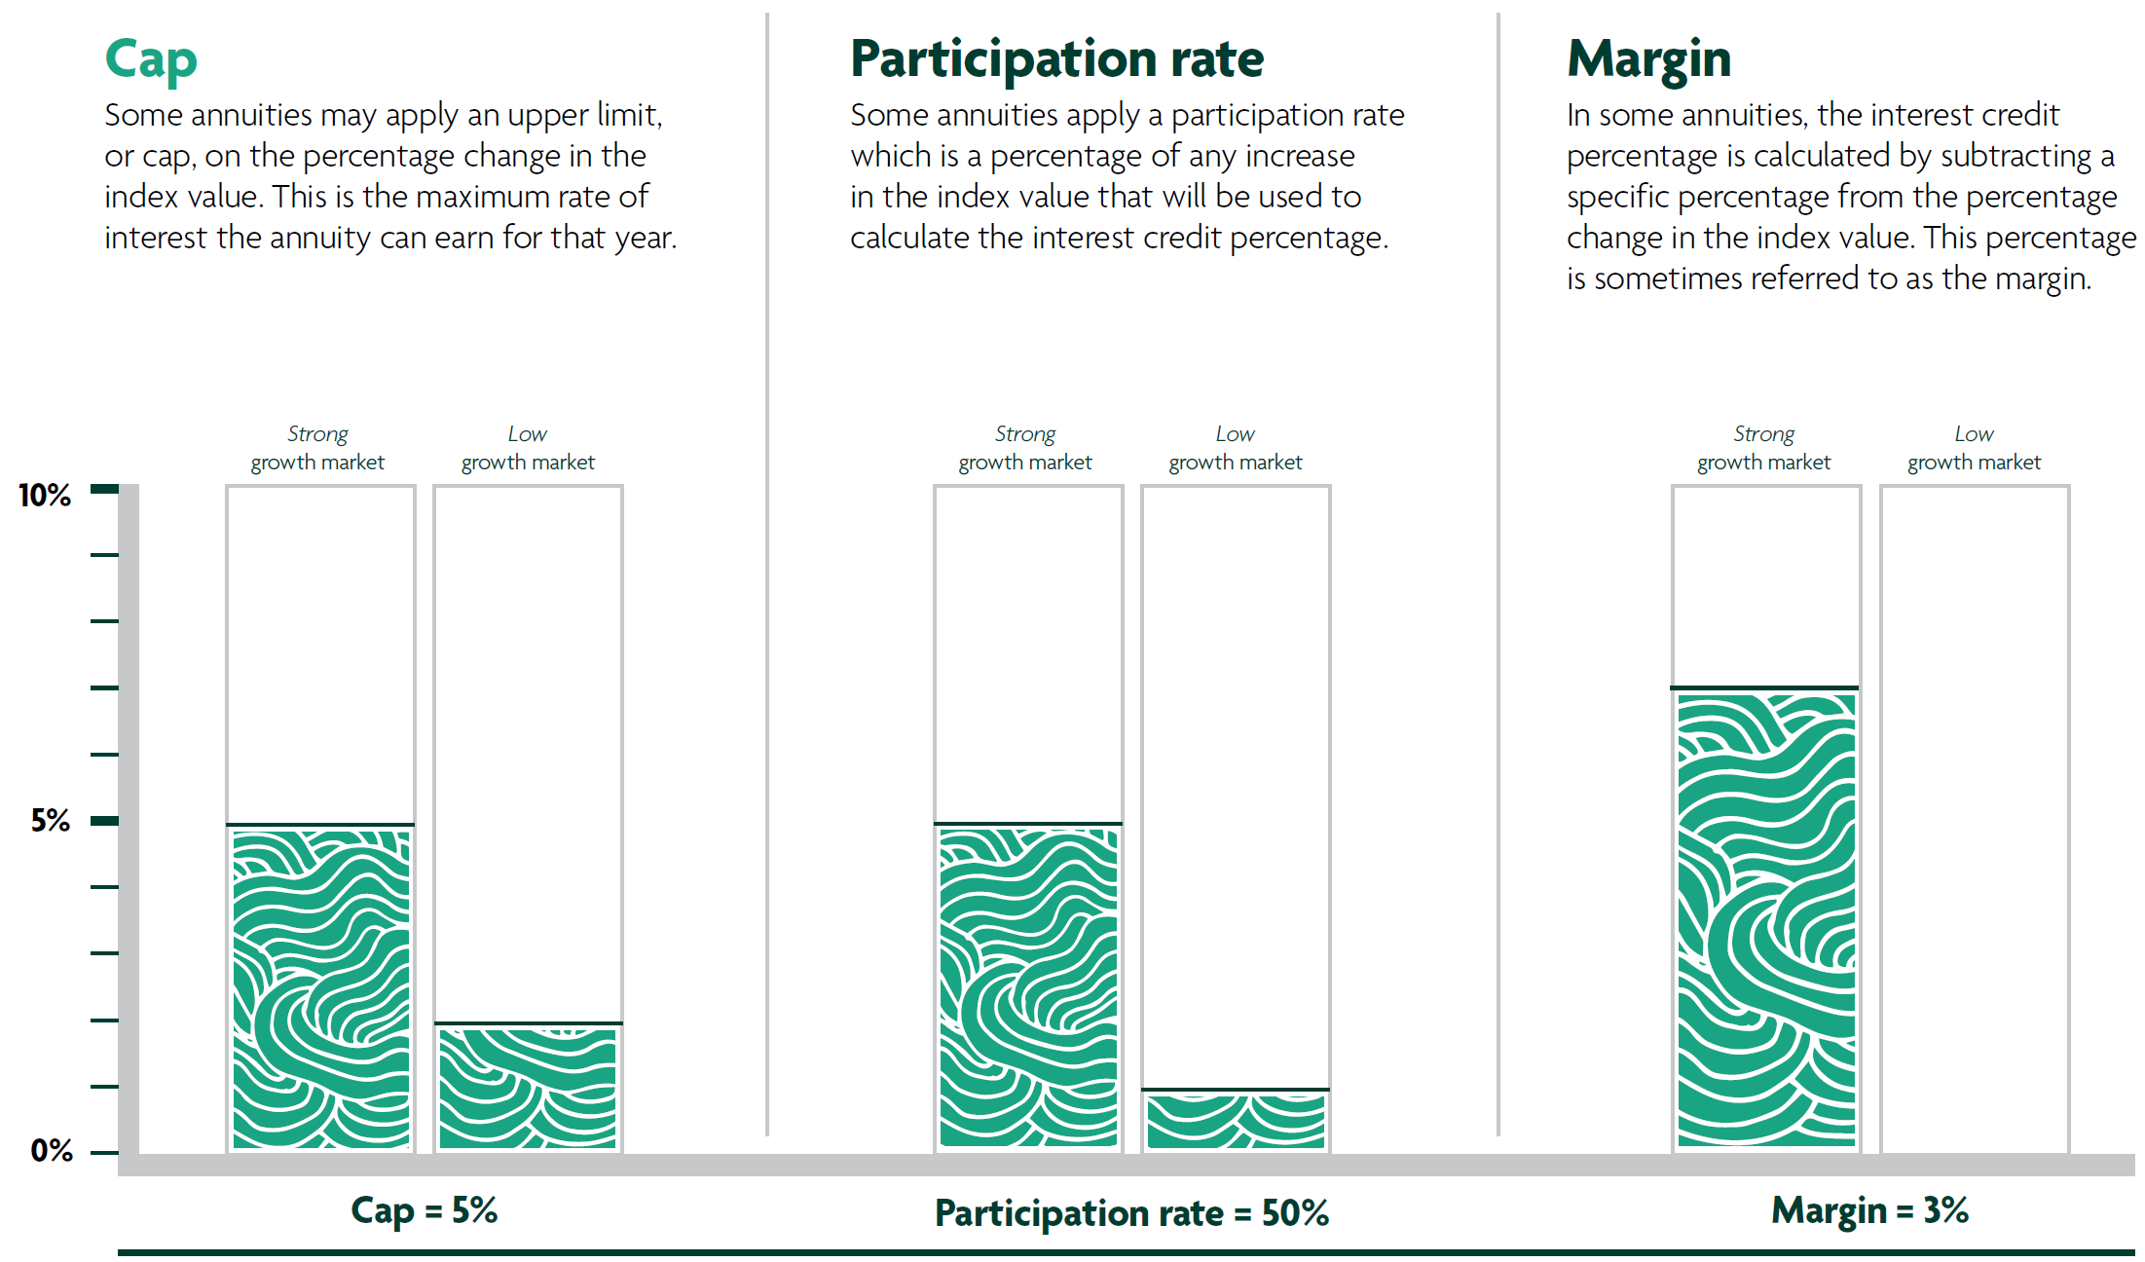
Indexing continued…
Cap
Some annuities may apply an upper limit, or cap, on the percentage change in the index value. This is the maximum rate of interest the annuity can earn for that year.
Participation rate
Some annuities apply a participation rate which is a percentage of any increase in the index value that will be used to calculate the interest credit percentage.
Margin
In some annuities, the interest credit percentage is calculated by subtracting a specific percentage from the percentage change in the index value. This percentage is sometimes referred to as the margin.
These hypothetical examples demonstrate how the cap, participation rate, and margin apply in a strong growth market (10%), and a low growth market (2%). Interest credit(s) will never be less than zero.
Page 7 of 17
Notes:
Clients may have questions about the differences between taxable and tax-deferred products.

Slide 8
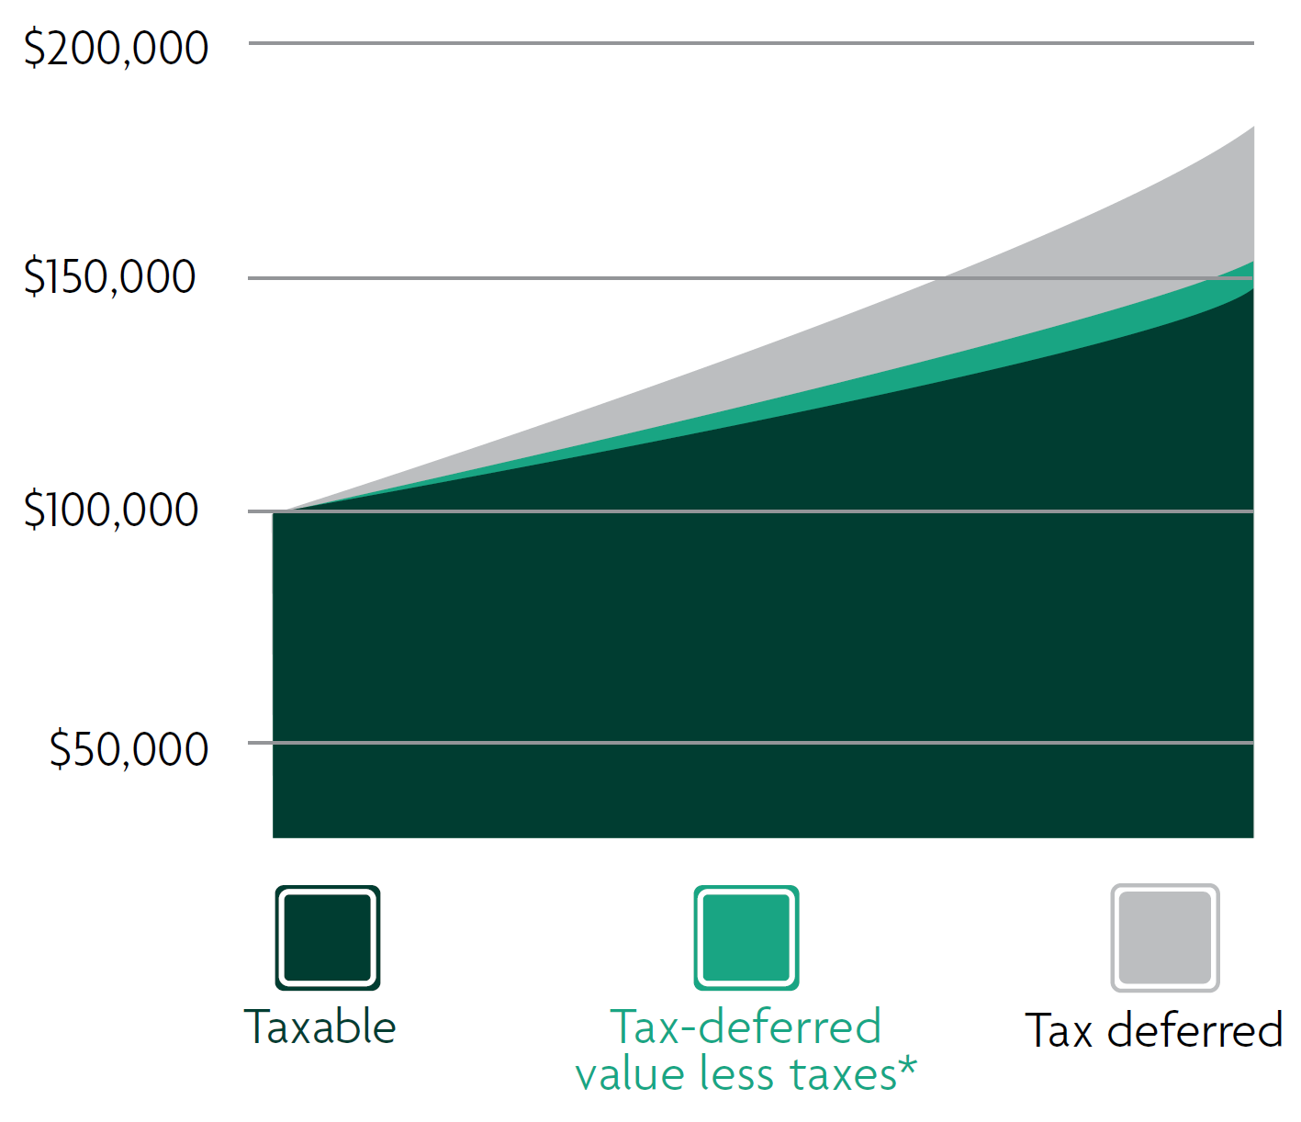
FIA highlights:
Tax deferral
You won’t owe tax on your fixed index annuity interest earnings until you or your beneficiaries start receiving income.
*The chart is a hypothetical example of tax deferral and assumes an initial premium of $100,000 earning 4% compounded annual rate of return for 15 years. It is not intended to predict or project performance.
*The tax-deferred value less taxes represents the increase in value, due to tax deferral, less taxes at an assumed rate of 33% with no surrender charge or market value adjustment (MVA), also known as interest adjustment, applied.
Under current law, annuities grow tax-deferred. An annuity is not required for tax deferral in qualified plans. Annuities may be subject to taxation during the income or withdrawal phase. Note: Neither North American, nor any financial professional acting on its behalf, should be viewed as providing legal, tax or investment advice. Consult with and rely on your own qualified advisor.
Page 8 of 17

Slide 9

FIA highlights:
Liquidity
If you have concerns about unplanned expenses, such as nursing home care, you may be able to adapt your FIA to changing life situations.
41421Z
PRT 9-26
Page 9 of 17
Notes:
If your client’s beneficiaries are adult children, it might be beneficial to plan a “family meeting” with all parties involved. This can allow you to create a holistic plan, as well as identify other assistance you can provide.

Slide 10

FIA highlights:
Leaving a legacy
Your FIA provides a death benefit to those you love in the manner that could best fit their specific financial needs.
Properly naming a beneficiary may help you avoid probate, which can be costly and
cause major delays.
41421Z
PRT 9-26
Page 10 of 17
Notes:
This is intended to show how FIAs relate in terms of risk and features.

Slide 11

Other financial
products
Which of these are you most familiar with?
Savings accounts
Money markets
CDs (Certificate of deposits)
Multi-year annuities
Fixed index annuities
Variable annuities
Stock mutual funds
Page 11 of 17
Notes:
This is an opportunity to show where FIAs fit on the risk spectrum. FIAs ensure the premium is protected from market downturns, which puts them below the line on the chart. There is no “best” product, but there are products that can be a better fit in order to help meet your clients’ goals.

Slide 12

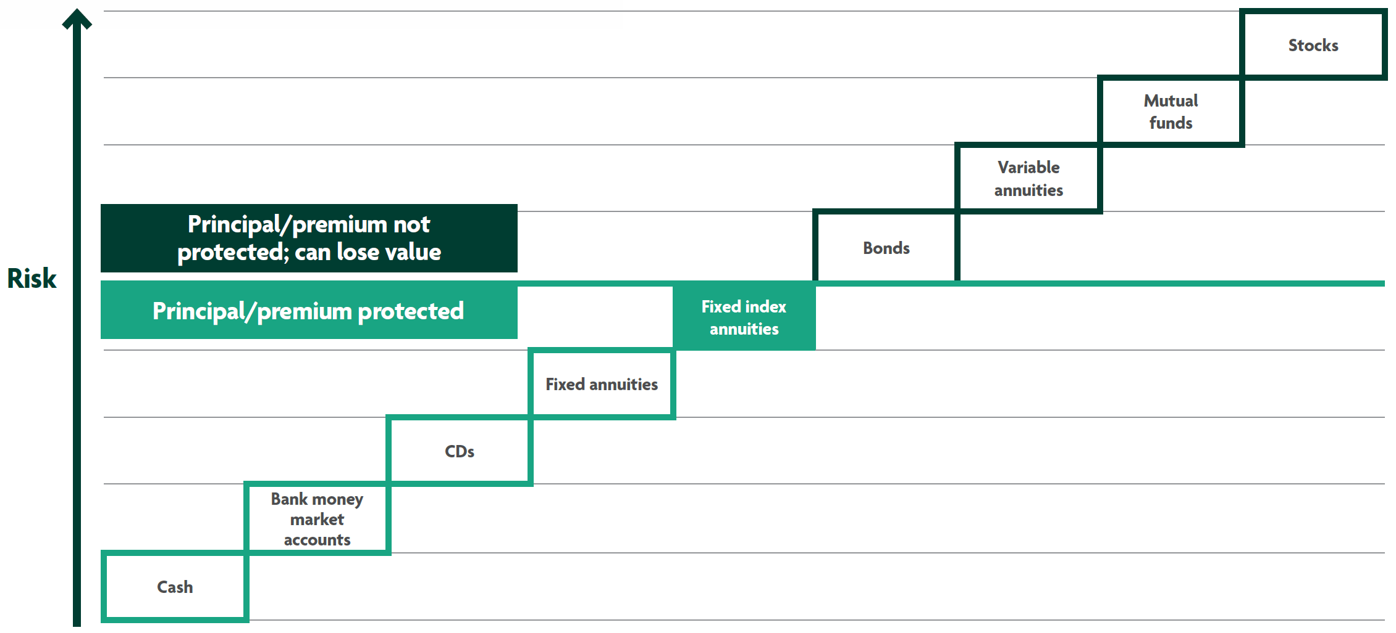
How FIAs compare:
Risk spectrum
The chart is meant to serve as a general guide of where FIAs may fall in the financial services spectrum of common products. It is not a guarantee of performance individually or performance correlation or safety of the above listed vehicles.
Page 12 of 17

Slide 13
How FIAs compare:
Features
“Income or lifetime income” refers to guaranteed payment of lifetime payment amounts (“LPAs”). It does not refer to interest credited to the contract. Consult with your own tax advisor regarding tax
treatment of LPAs, which will vary according
to individual circumstances.
 | Safety of principal/premium | Tax deferral | Guaranteed lifetime income | Growth potential
Savings account | P
Certificate of deposit (CD) | P
Money market | P
Multi-year fixed annuity | P | P | P
Variable annuity |  | P | P | P
Stock mutual fund |  |  |  | P
Fixed index annuity | P | P | P | P
Page 13 of 17

Slide 14
A+
North American
at a glance
Our roots go back more than 138 years with the 1886 founding of North American
Accident Association.
For the last 30+ years, North American has consistently earned high ratings based on our financial strength, operating performance and ability to meet obligations to our policyholders and contract holders.
“A+” (Superior) A.M. Best^{A,B} - (Second category out of 15)
“A+” (Strong) S&P Global Ratings^{B,C} - (Fifth category out of 22)
“A+” (Stable) Fitch Ratings^{D}- (Fifth category out of 19)
A.M. Best is a large, third-party independent reporting and rating company that rates an insurance company on the basis of the company’s financial strength, operating performance, and ability to meet its obligations to policyholders. S&P Global Ratings is an independent, third-party rating firm that rates on the basis of financial strength. Ratings shown reflect the opinions of the rating agencies and are not implied warranties of the company’s ability to meet its financial obligations. The ratings apply to North American’s financial strength and claims-paying ability. A) A.M. Best rating affirmed on September 6, 2026. For the latest rating, access ambest.com. B) Awarded to North American as part of Sammons® Financial Group Inc., which consists of Midland National® Life Insurance Company and North American Company for Life and Health Insurance®. C) S&P Global rating assigned Feb. 26, 2009 and affirmed on June 10, 2026. D) Fitch Ratings, a global leader in financial information services and credit ratings, on June 10, 2026, assigned an Insurer Financial Strength rating of A+ Stable for North American. This rating is the fifth highest of 19 possible rating categories. The rating reflects the organization’s strong business profile, low financial leverage, very strong statutory capitalization and strong operating profitability supported by strong investment performance. For more information access fitchratings.com.
Page 14 of 17

Slide 15

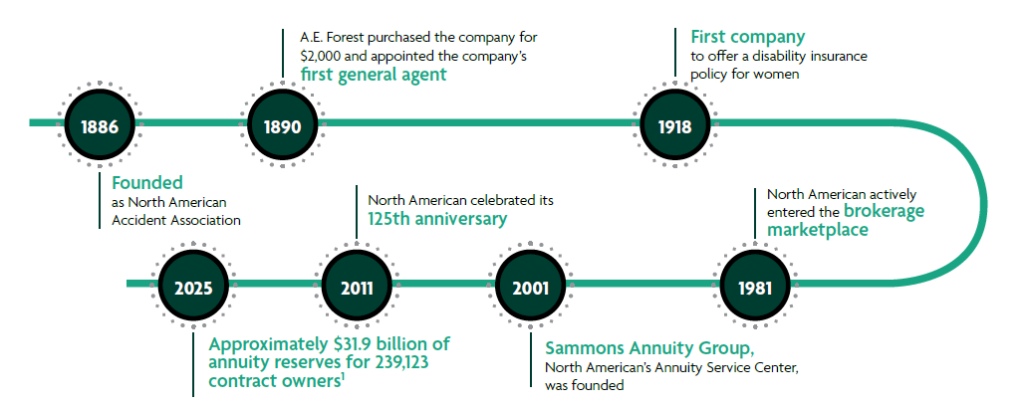
North American
Stability
From our earliest days in 19th century Chicago to a brave new world of the 21st century, North American has a history of innovating and evolving as the industry - and the country itself - has grown. Throughout our 138 year history, we’ve helped provide growth, income and financial protection to the clients we serve. Our annuity products have consistently provided value to our clients – in all types of market and economic environments.
1. North American Annual Statement 2025
Page 15 of 17
Notes:
Now that you have a better understanding of your client’s desired product features, visit the North American website to run an illustration, use Annuity e-Biz, download materials (brochures, forms), and more.
Review our fixed index annuity portfolio snapshot piece (24279Z) to view product benefits, features and highlights.

Slide 16
Could a FIA
help you?
Which of the benefits we talked about are most valuable to you
Guaranteed lifetime income
Accumulation and growth
Leaving a legacy
Page 16 of 17

Slide 17

Exploring
fixed index annuities
Sammons Financial® is the marketing name for Sammons® Financial Group, Inc.’s member companies, including North American Company for Life and Health Insurance®. Annuities and life insurance are issued by, and product guarantees are solely the responsibility of, North American Company for Life and Health Insurance®.
Fixed index annuities are not a direct investment in the stock market. They are long term insurance products with guarantees backed by the issuing company. They provide the potential for interest to be credited based in part on the performance of specific indices, without the risk of loss of premium due to market downturns or fluctuation. Although fixed index annuities guarantee no loss of premium due to market downturns, deductions from the accumulation value for optional benefit riders or strategy fees or charges associated with allocations to enhanced crediting methods could exceed interest credited to the accumulation value, which would result in loss of premium. They may not be appropriate for all clients. Interest credits to a fixed index annuity will not mirror the actual performance of the relevant index.
41421Z
PRT 9-26
Page 17 of 17

